Slide 1

Final Presentation
Sponsor - Toyota
Faculty Advisor - Patrick Tague, Jia Zhang
Team Members: Hyo Jeong, Ambarish Karole, Grace Lee, AJ Ruiz, Harikumar Kumar Sulochana

Slide 2
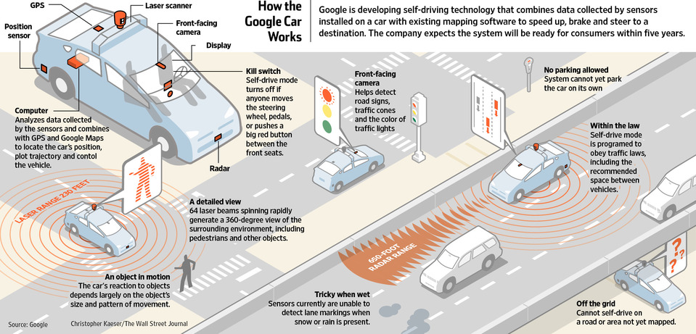
Project Background: Toyota: Development of Collaborative
Vehicular Cloud Services
Given that more and more vehicles are laden with various sensors and that we are headed to a future where in driverless smart cars will be a common sight, there is a pressing need for an infrastructure which will support such services.
Notes:
Brief Context: about this project (short introduction to the problem we are trying to solve)
Traditional Cloud computing is great but not Real time
There are significant real-time constraints that may limit the use of traditional cloud APIs and services for collaborative data sharing and processing.

Slide 3
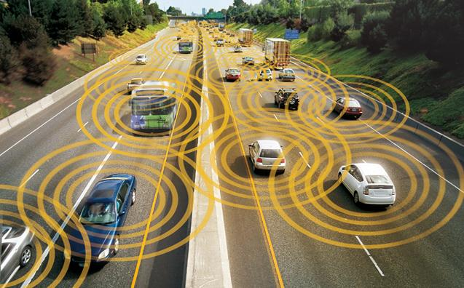

Project Background
Traditional Cloud computing is great but not Real time
There are significant real-time constraints that may limit the use of traditional
cloud APIs and services for collaborative data sharing and processing.
A promising approach is for a group of vehicles to create their own mobile cloud.
Notes:
Brief Context: about this project (short introduction to the problem we are trying to solve)
Traditional Cloud computing is great but not Real time
There are significant real-time constraints that may limit the use of traditional cloud APIs and services for collaborative data sharing and processing.

Slide 4
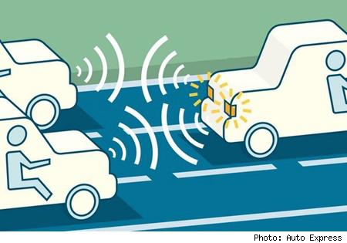
Project Background- Mobile Cloud Computing
Driven by increasing storage and processing capacity of mobiles and the need to communicate and keep locally relevant content on the mobiles instead of uploading to cloud
Each vehicle is a node in the mobile cloud. Cars offer higher processing speed and storage
Notes:
2. difference between cloud computing
5. e.g as well

Slide 5

Project Background- Mobile Cloud Computing
Why MCC (need for MCC):
Advantages of mobile mini-clouds over global cloud are reduced communication delay, reduced spectrum costs, and amply expanded range of applications.
Mobile devices are improving in storage and processing capabilities, so network latency can be reduced by offloading the cloud processing to local nodes.
Mobile agents can be both users as well as service providers
Mobile node can interact and collaborate to sense environment, process data,
propagate results and more generally share resources.
Notes:
2. difference between cloud computing
5. e.g as well

Slide 6
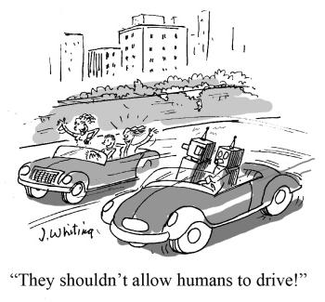
Project Background- Mobile Cloud Computing
We have built a Proof Of Concept for a middle tier application that will enable us to provide infrastructure for supporting these different use cases.
Toyota Use cases
TUS 1 Driver Safety - Collaborative sensing ( negotiating a blind turn or backing out of parking space)
TUS 2 Driver Safety - Merge assistant
TUS 3- Collaborative services - Navigation
TUS 4- Collaborative services- Emergency assistance
TUS 5 - Co-ordinated driving/platooning
TUS 6 - In Vehicle entertainment - Shared content markets
Notes:
2. difference between cloud computing
5. e.g as well

Slide 7
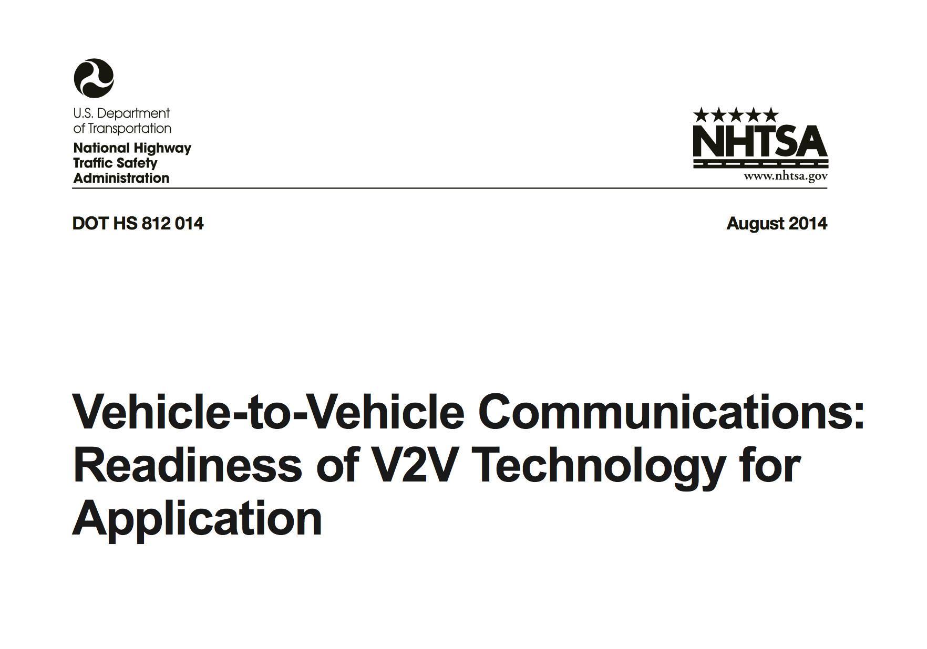
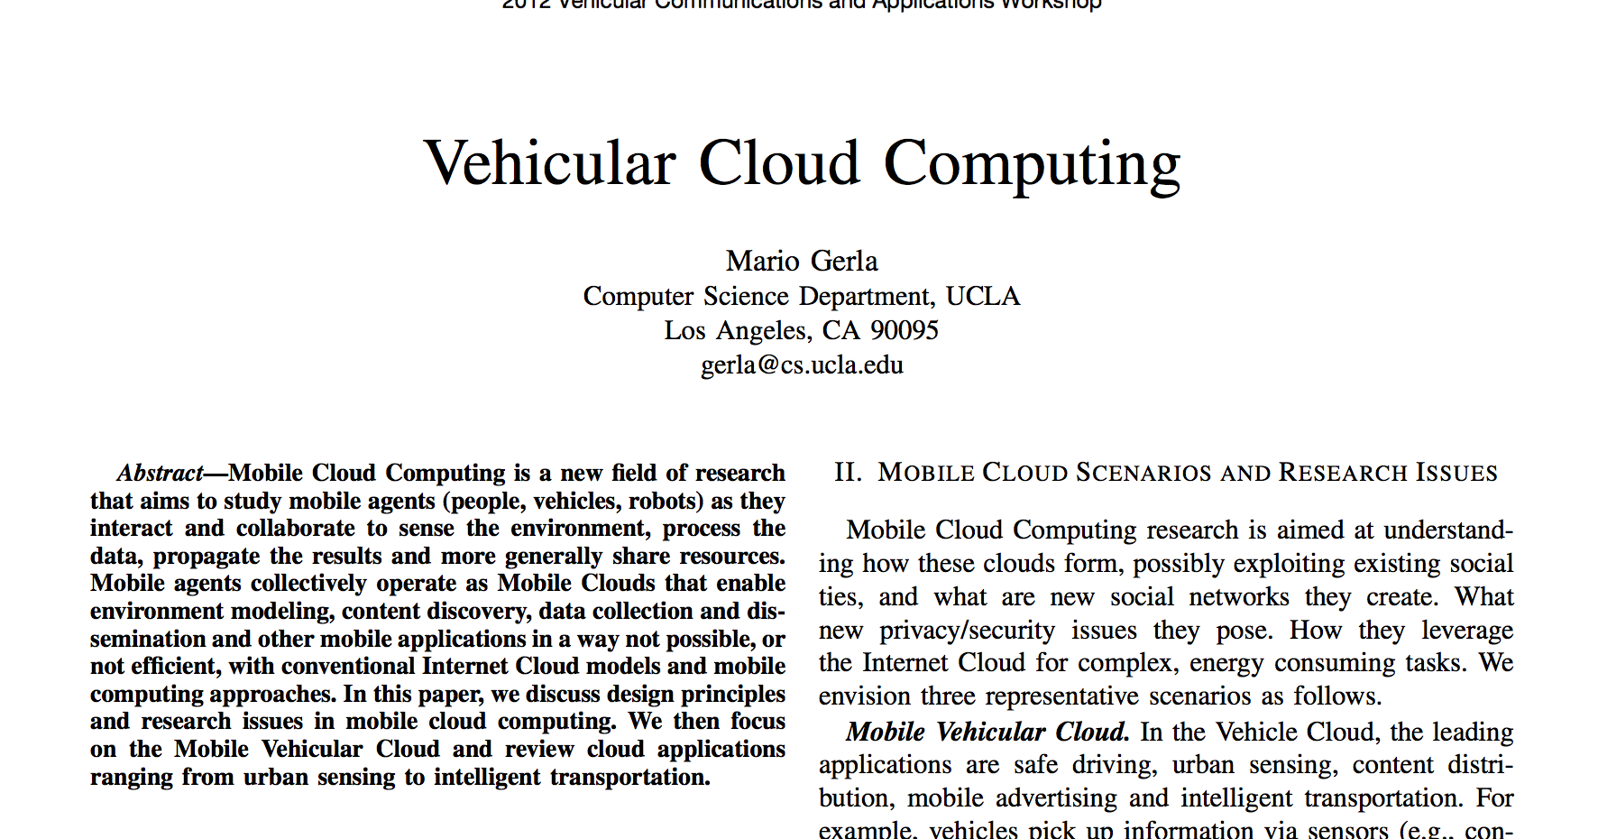
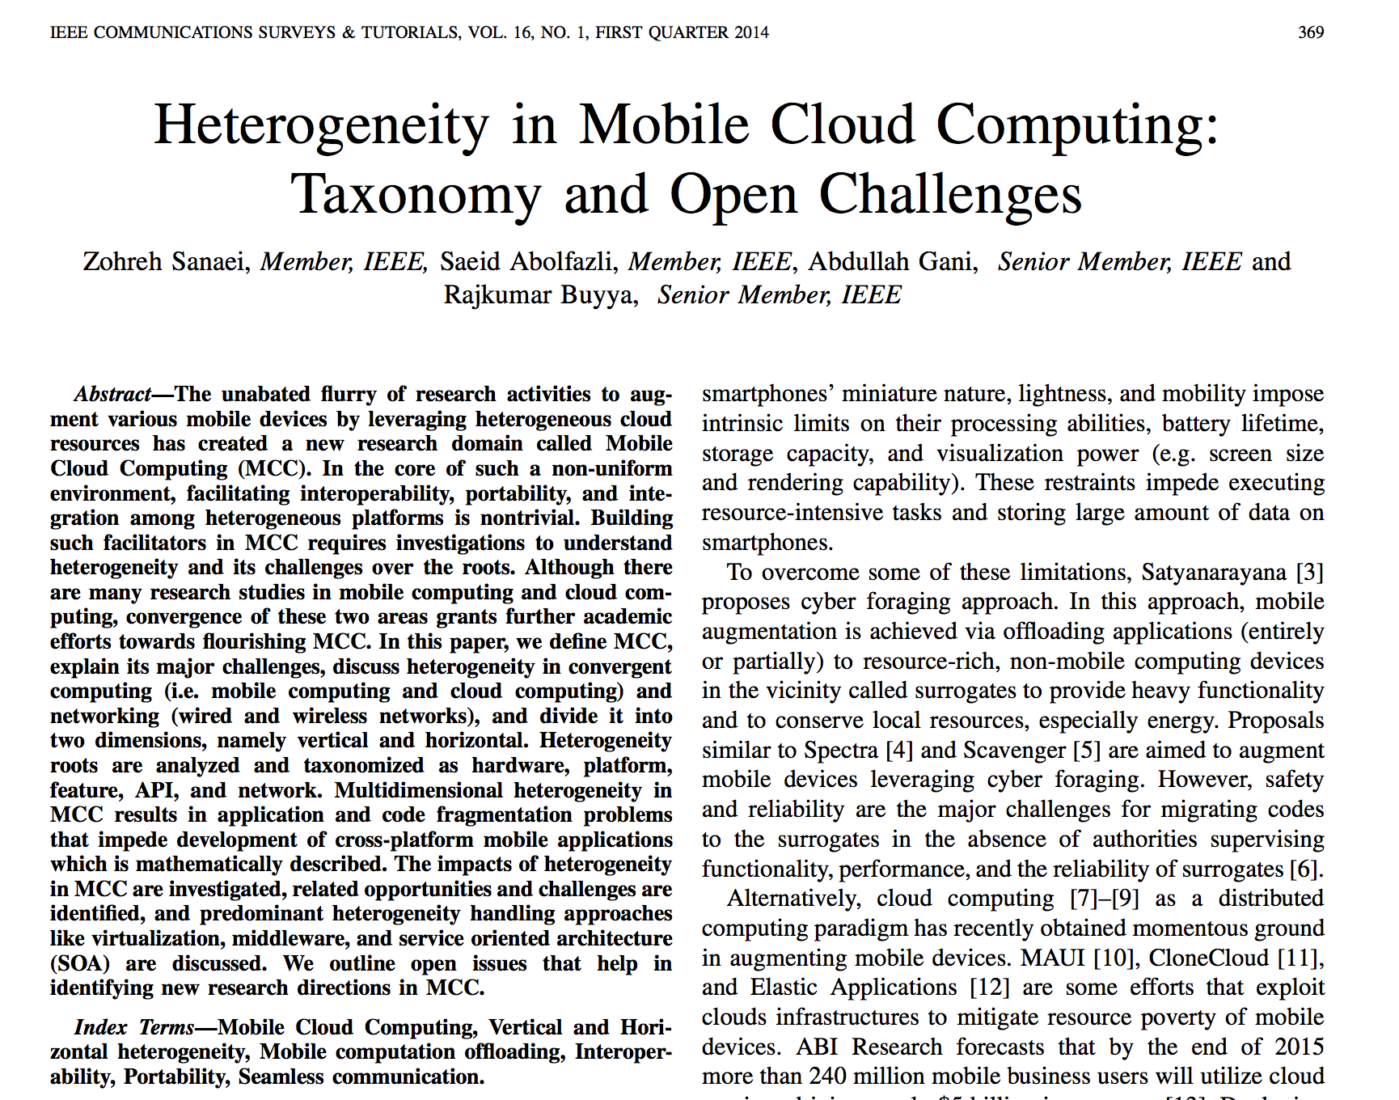
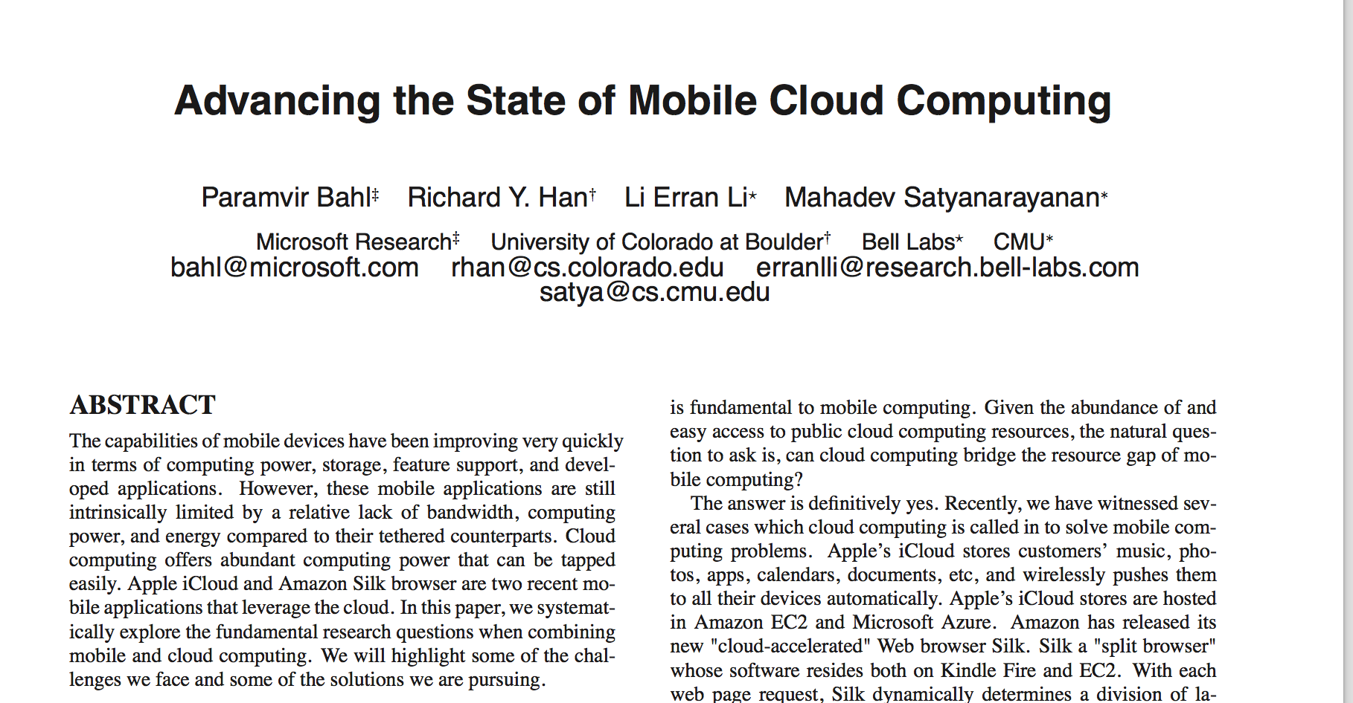
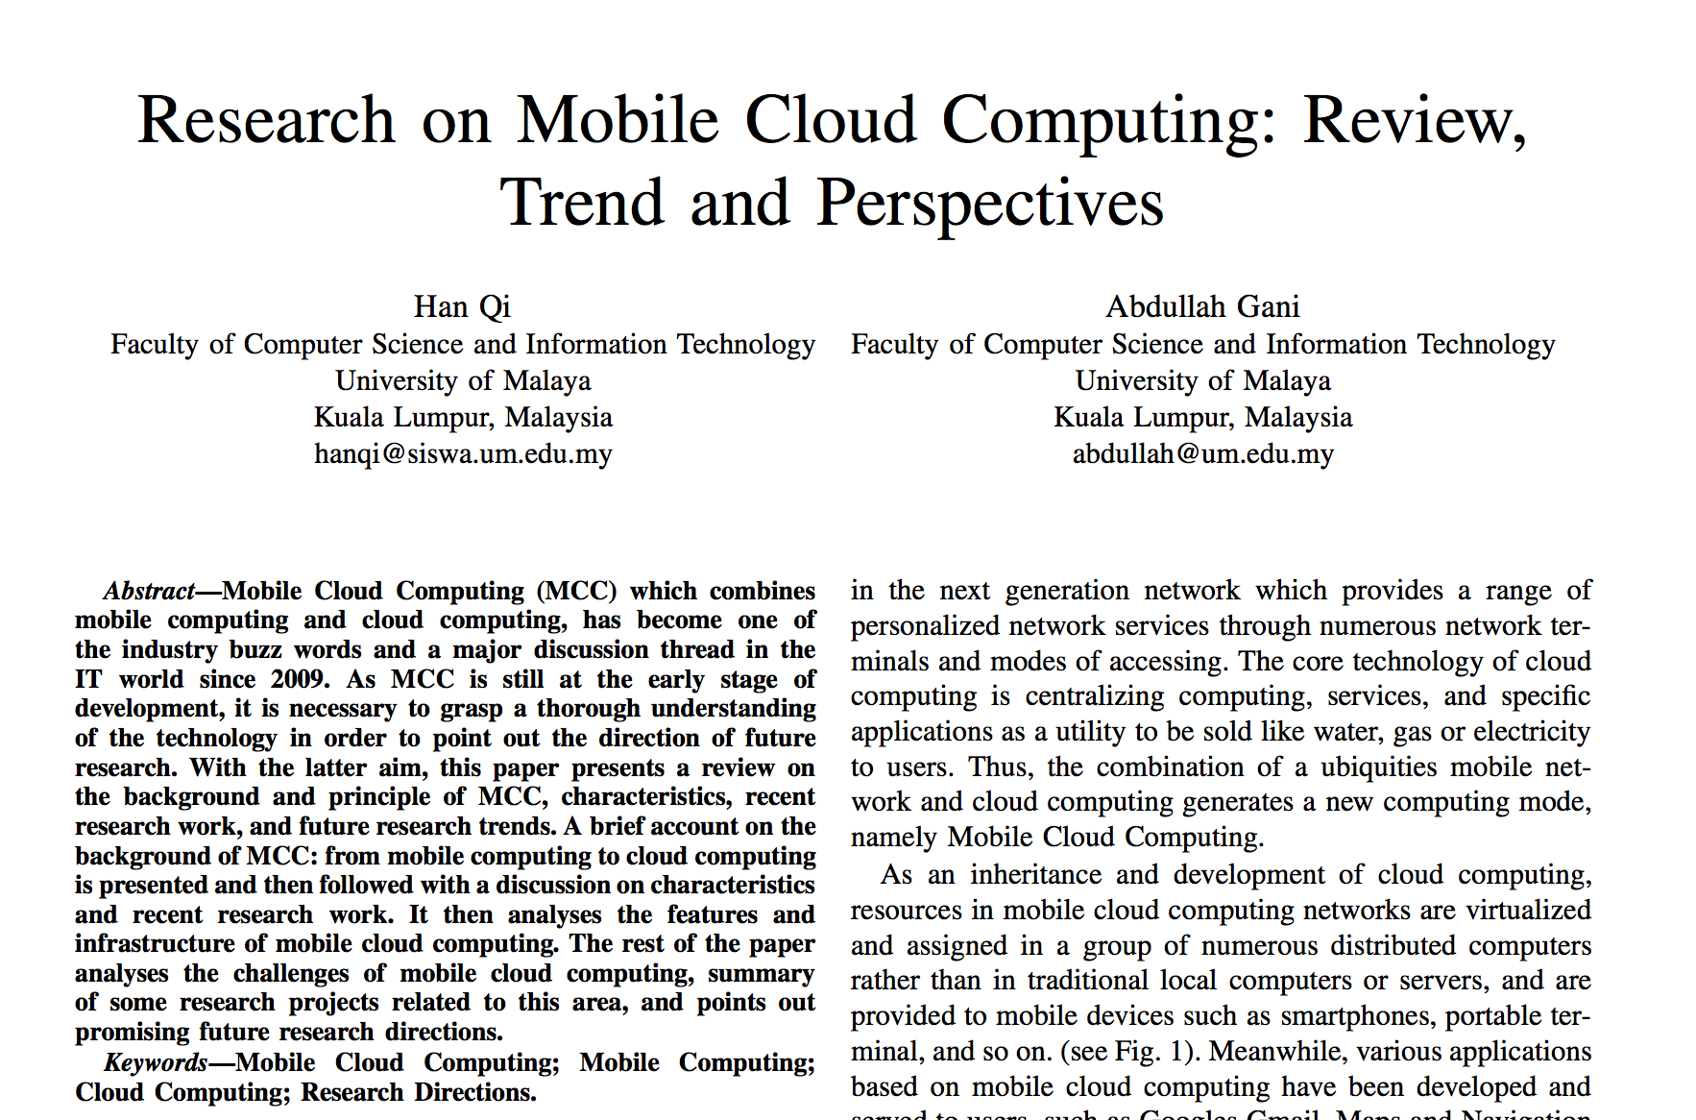
Related Work
Notes:
notes and papers from Patrick’s stuff (1 or 2 slides)
Ambarish
TBD
Say lot of related work in cloud computing, little of related work on mobile cloud computing. Couple of the papers include: …
People are trying to do android based shared processing, etc There are extensions to this that we are interested in looking at from Vehicle pov.

Slide 8
System Design
Key to design
Distributed Querying API
Distributed Processing API
Platform independent- runs on a JVM
APIs can be individually deployed as they use different stacks

Slide 9
Distributed Querying API Design
Enable querying of vehicles within proximity for information
Use-cases such as in-vehicle entertainment, emergency response and traffic safety.
Notes:
Building the mobile cloud:
How do you build it?
What’s in it?
Features we need
API, protocols
Use cases

Slide 10
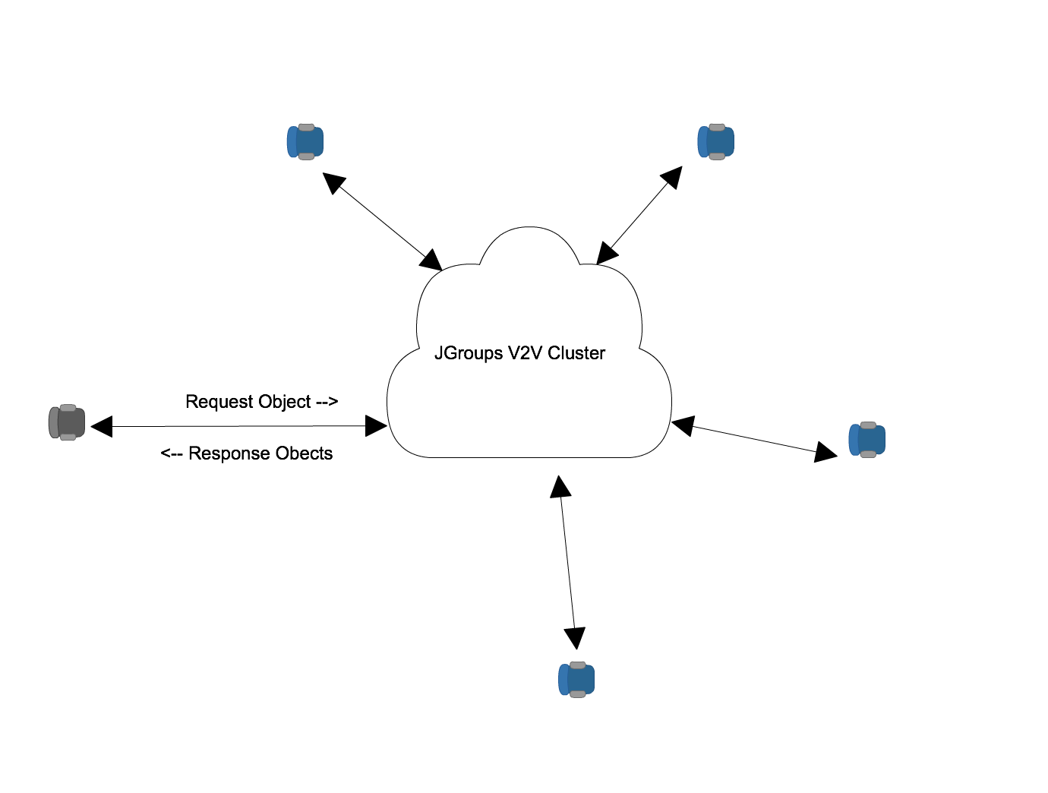
Distributed Querying API Design

Slide 11
Distributed Querying API-Modes
Querying mode Primary use-case and useful when a vehicle need to get information from vehicles around it and then process it
Informing mode Faster for appropriate response Inform vehicles around a vehicle of its status Example “I had an accident and I have stopped at this location”

Slide 12
Distributed Querying Implementation
Jgroups
Toolkit for reliable messaging
Create clusters of nodes
Detection of new and departed/crashed nodes
Point-to-multipoint and point-to-point
Supports UDP(IP Multicasting) or TCP
Notes:
Technology stack decisions
OpenStacks
AWS
JGroups
How we set up our demo system
Talk about how to install, setup the system, how to make changes...

Slide 13
API Usage - Quick Peek
Starting the demo cluster
JgroupsRpc jgroupsRpc = JgroupsRpc.getInstance() jgroupsRpc.start();
Querying the cluster
RspList<Vehicle> rsp_list=jrpc.dispatch(ResponseMode.GET_ALL, 5000, new Vehicle(), Vehicle.class);
List<Vehicle> it= rsp_list.getResults();
Informing the Cluster
Vehicle vehicleWithAccident = new Vehicle(); vh.setHasAccident(true); jrpc.dispatch(ResponseMode.GET_ALL, 5000, vehicleWithAccident, Vehicle.class);

Slide 14
Distributed Querying Implementation
Required Libraries:
Maven 3+
Java SDK 1.7
Recommended IDE:
Eclipse
Source Code
https://github.com/harikumarks/v2v.

Slide 15
Distributed Querying - Constraints
Applicability depends on the dynamics of the cloud
Response time depends on the processing capabilities
Response time can vary depending on number of vehicles in the cloud so there should be a manager

Slide 16
Distributed Querying API - Further
Initial results seems promising
Suggested that simulation testing is done
Stress Testing to be done to ensure stability of cluster and decide most stable version of Jgroups release

Slide 17
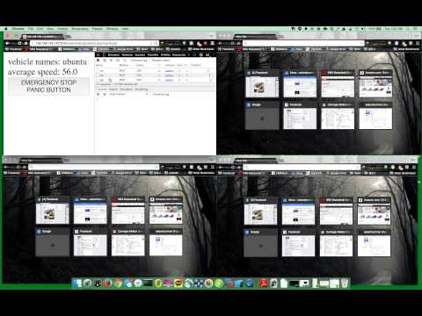
Distributed Querying Demo

Slide 18
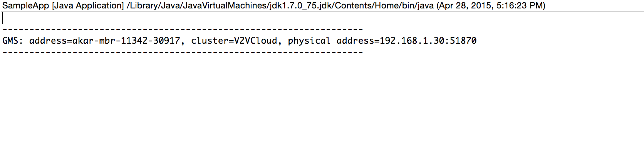
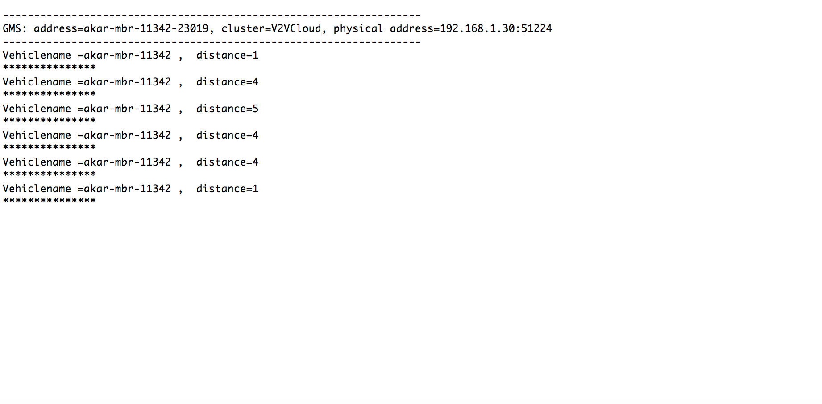
Android Demo
Process:
Query:

Slide 19

Android Demo

Slide 20
Distributed Processing System Design
Goal
Provide middle tier application that enables a vehicle to request other vehicles to process information.
Use Cases
In-Vehicle Entertainment, Vehicle Safety
Notes:
In vehicle entertainment - video processing
***vehicle safety (example needs to be more concrete) -
processing sensor data in a distributed manner.
Best route calculation.

Slide 21


Distributed Processing System Design
Processed data
Processed data
Data Stream
Data Stream
Data Stream
Data Stream
Mobile Cloud

Slide 22
Distributed Processing Implementation
Technology Stacks Considered:
 | Pros | Cons
OpenStack | well-documented and widely used cloud computing platform Scalable, reliable, fault-tolerant | No real-time distributed processing capability
Apache Storm | Real-time distributed processing capability Scalable, reliable, fault-tolerant, and fast | Not as widely used as OpenStack (doesn’t have MarketPlace for plug-ins,etc)
Hyrax | Specifically developed to enable mobile cloud computing. Already works on Android CMU product | Lack of documentation and support group. Difficult to get hold of the source code In beta stage
Notes:
Technology stack decisions
OpenStacks
AWS
JGroups
How we set up our demo system
Talk about how to install, setup the system, how to make changes...

Slide 23
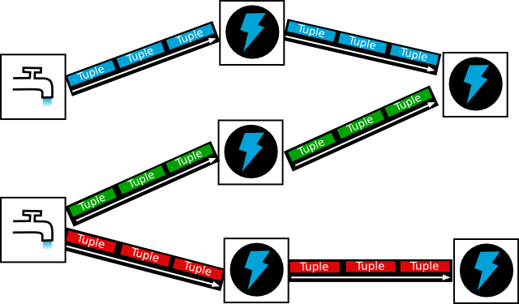
Distributed Processing Implementation
Storm Topology
Notes:
Tuple: Core unit of data. Immutable set of key/value pairs.
Streams: Unbounded sequence of tuples
Spout: source of streams. Responsible for data input.
Bolts: Core functions of a streaming computation. Receives tuples and does computation on them.
Topology: Is a description of a workflow. It defines how the code you write is put together and executed. Storm executes spouts and bolts as individual tasks that run in parallel on multiple machines.

Slide 24
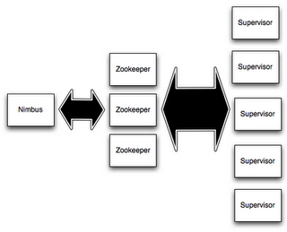
Distributed Processing Implementation
Storm Cluster
Notes:
Nimbus handles scheduling of tasks in the cluster. Supervisor supervises the process that actually executes your code. Zookeeper handles cluster management.
Topology submitter uploads topology (jar file to the Nimbus)
Nimbus calculates assignments and sends to Zookeeper.
Supervisor nodes receive assignment info from Zookeeper
Supervisor nodes download topology from Nimbus
Supervisor spawn workers (JVM processes) to start the topology
How it achieves parallelism:
Each supervisor is a machine. And multiple JVMs (workers) are run on each machine (supervisor) and uses many threads per JVM (executors)
Reference:
http://www.slideshare.net/ptgoetz/storm-hadoop-summit2014
http://jansipke.nl/storm-in-pictures/

Slide 25
Distributed Processing Implementation
StormCV
StormCV enables the use of Apache Storm for video processing by adding computer vision (CV) specific operations and data model. The platform enables the development of distributed video processing pipelines which can be deployed on Storm clusters.

Slide 26
Distributed Processing Implementation
Storm CV
StormCV API
StormCV Models
Serializers
OpenCV Operations
Apache Storm API
OpenCV API

Slide 27
Distributed Processing Implementation
Required Libraries:
Maven (for building and execution)
https://maven.apache.org/
Apache Storm
https://storm.apache.org/
StormCV (OpenCV included)
Recommended IDE:
Eclipse

Slide 28
Distributed Processing Implementation
StormCV Installation and execution on the Local Cluster
Installation:
https://github.com/yglee/StormCV.git
Execution (also see README on the github page):
From StormCV/stormcv directory, run
mvn compile exec:java -Dstorm.topology=[topology name]

Slide 29
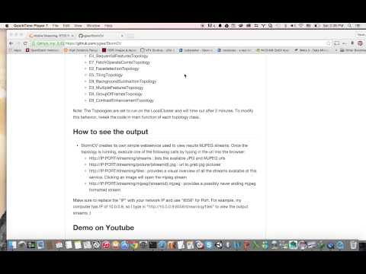
Storm CV Demo
https://www.youtube.com/watch?v=4PlpfhPExww

Slide 30
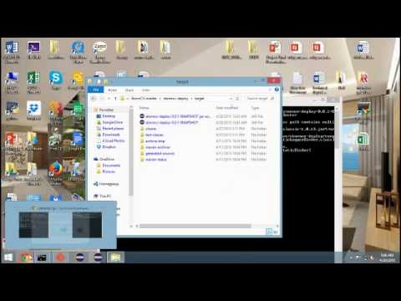
Remote Cluster Demo
How to setup a remote cluster on AWS and deploy StormCV topologies
Installation: https://github.com/KasperMadsen/storm-deploy-alternative.git
Demo: https://www.youtube.com/watch?v=PPHUY6cyMkk

Slide 31
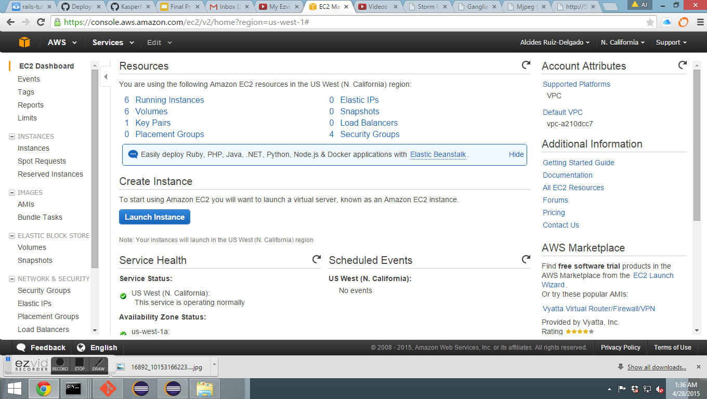
Experiments and Analysis
Deploying to a Remote Cluster

Slide 32
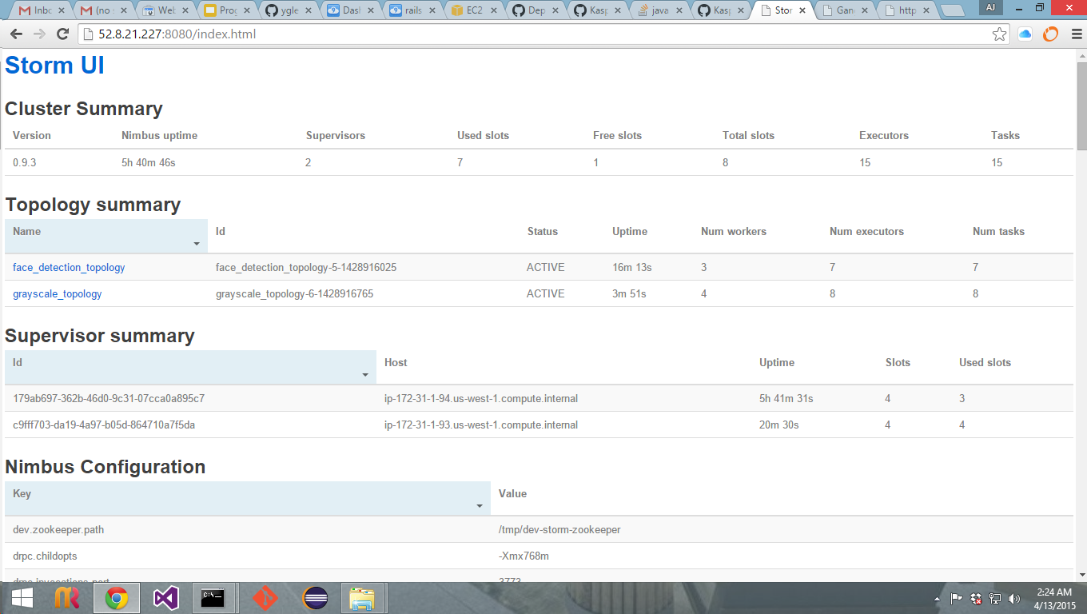
Experiments and Analysis
Unit Test Infrastructure

Slide 33
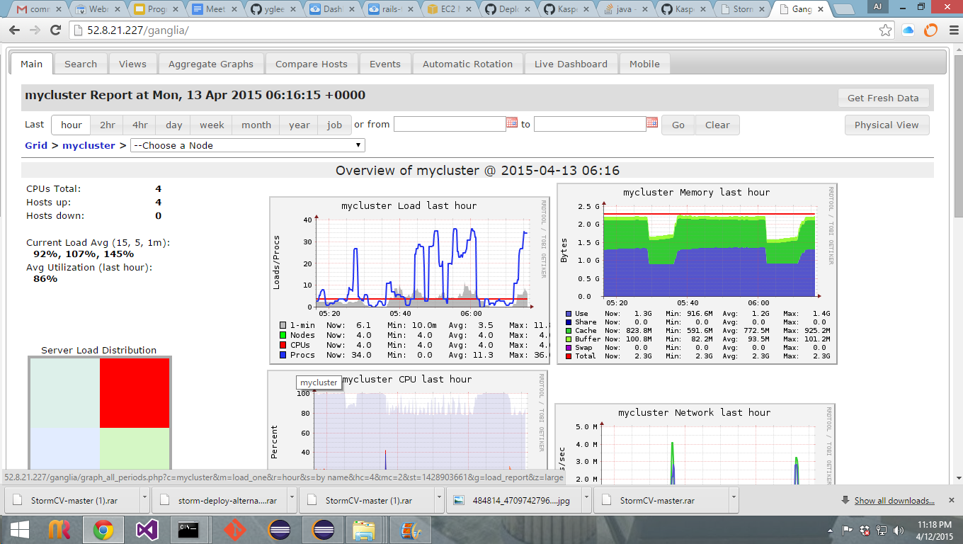
Experiments and Analysis
Performance Metrics

Slide 34
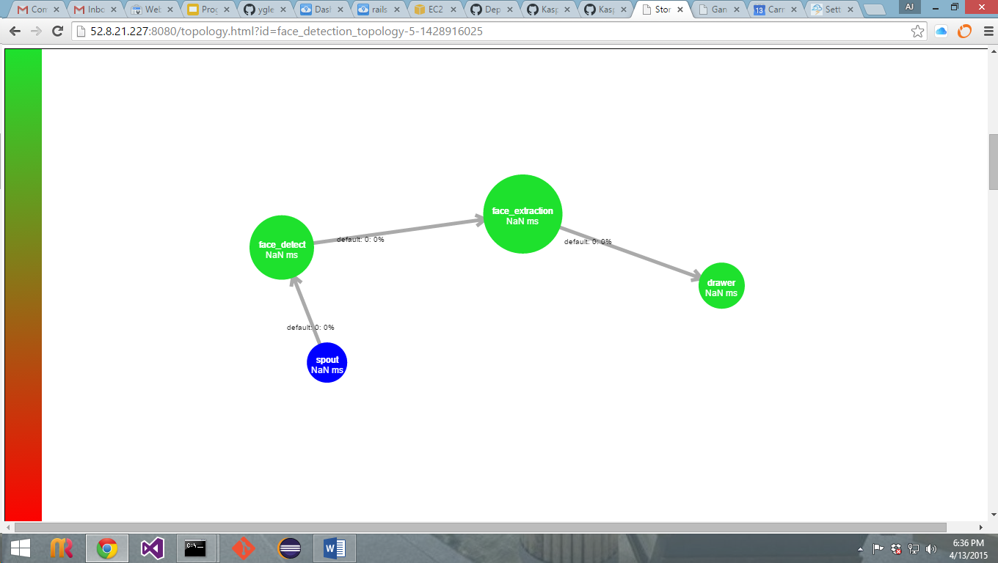
Experiments and Analysis
Topology Visualization

Slide 35
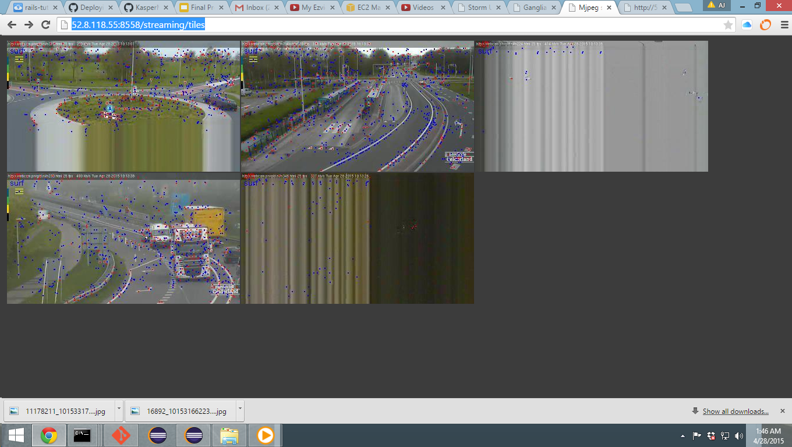
Experiments and Analysis
Web Service

Slide 36

Experiments and Analysis
Final Analysis of Remote Cluster
Simulation of a real world environment
Tracking and sharing of performance metrics
Qualitative and Quantitative Data
Unit Test Infrastructure
Slow if cheap
Expensive if fast

Slide 37

Known issues and bugs
Feature Detection
Testing infrastructure is slow
Notes:
The feature detection fails when trying to use an OpenCV function
→ Incompatibility with OpenCV and StormCV Library.
As AJ mentioned testing infrastructure is slow because we are using commoditiby hardware because this is proof of concept. so for development local cluster.

Slide 38

Integration with other team
Notes:
submitted some docs already
will send final report and slides.

Slide 39

Conclusion and Future Work

Slide 40

Questions

